Slide 1
Pop Art
Using Photoshop

Slide 2
A brief introduction to pop art
Pop Art was a movement in the 50s and 60s
It was brash, bold and bright
It was aimed at a youthful mass-market
Pop Art focussed on American popular culture
Even British Pop Artists created pieces that were America-centric

Slide 3
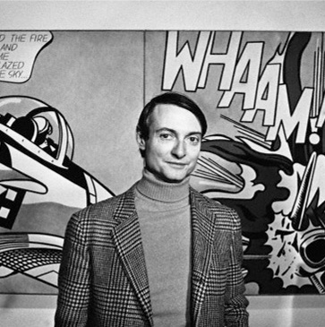
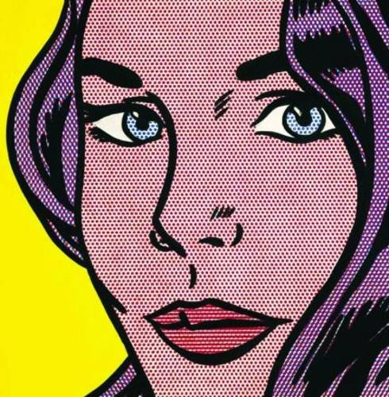
Some important artists
Roy Litchenstein

Slide 4
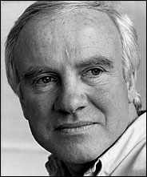
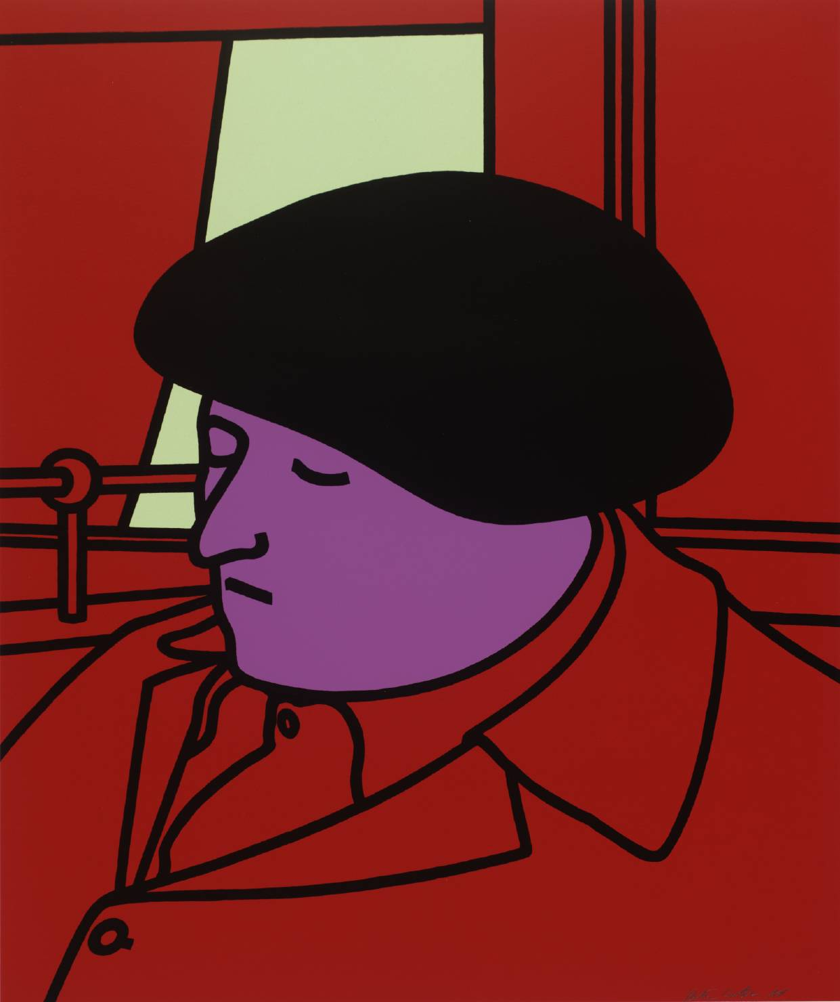
Some important artists
Patrick Caulfield

Slide 5
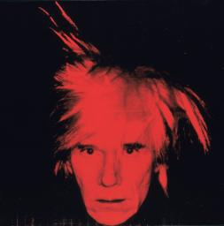
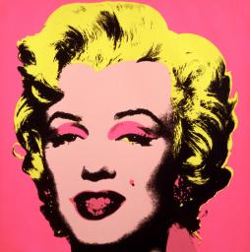
Some important artists
Andy Warhol

Slide 6
Similarities between styles
Use flat, bold colours
Little detail
Thick, black outlines
Background often bright

Slide 7
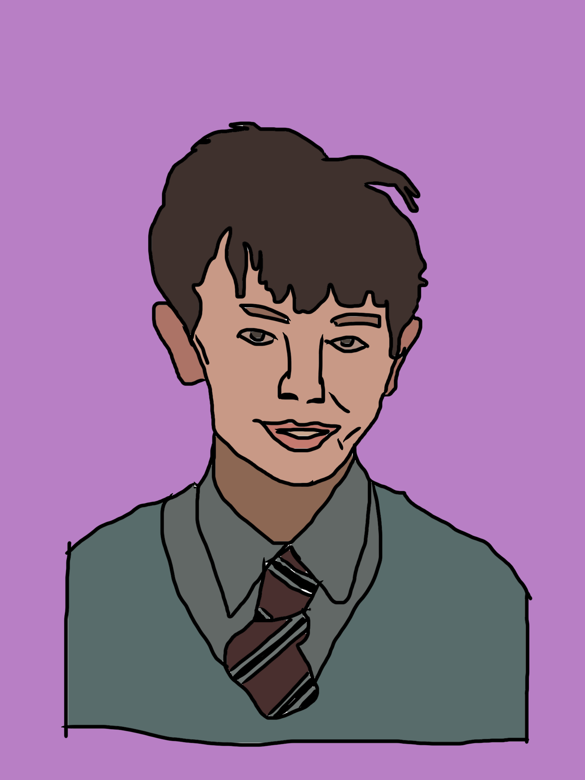
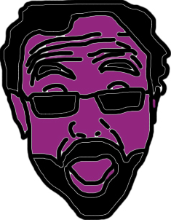
Turn yourself into pop art
Using Photoshop, you can turn yourself into a Pop Art portrait

Slide 8
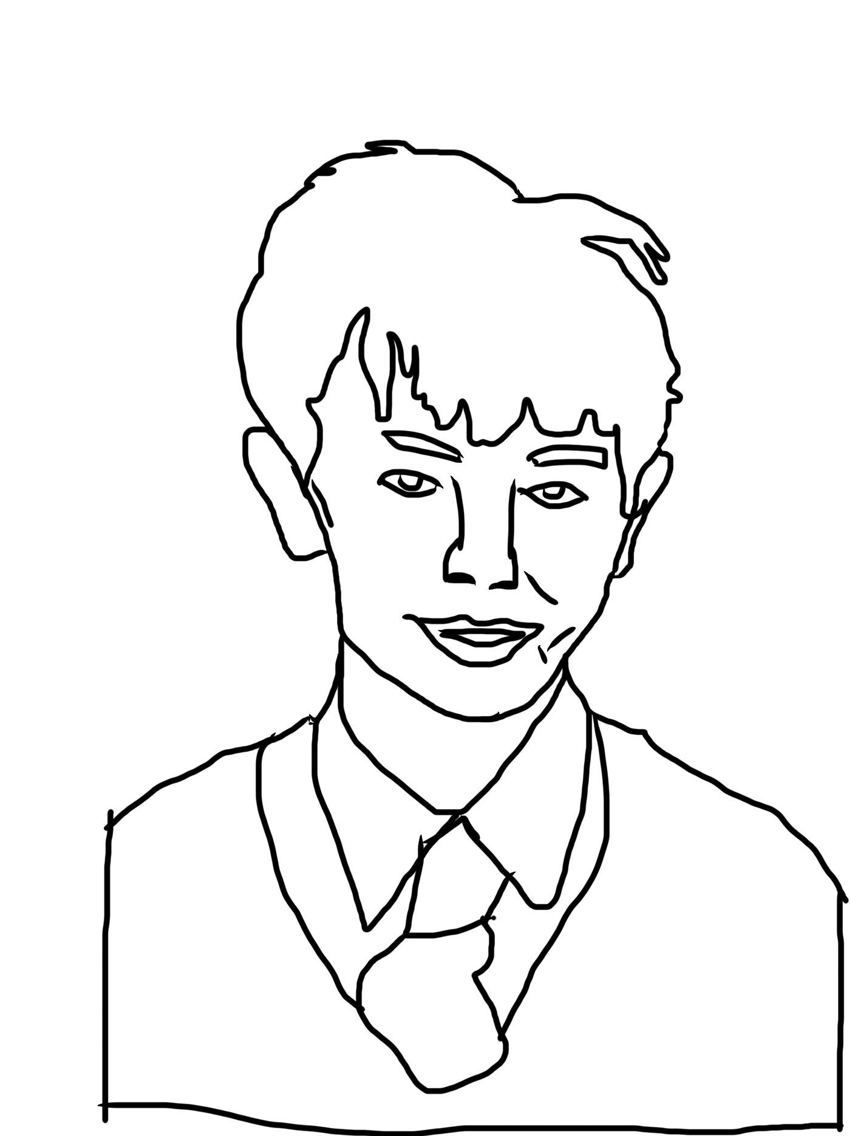
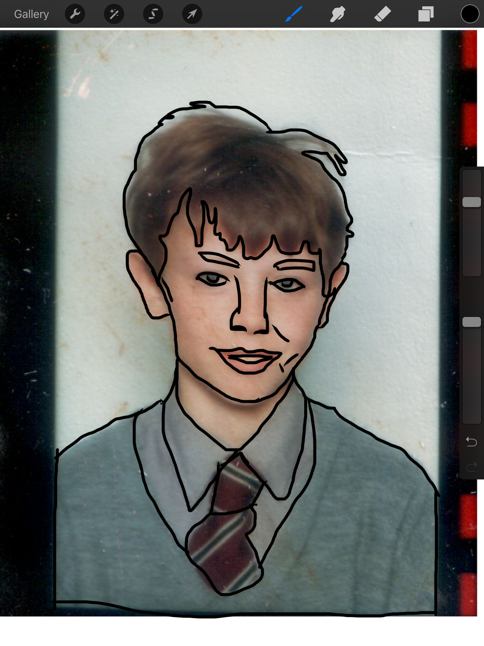
Basic steps
1. Get a photo of yourself.
2. Import it into Photoshop and create a new layer to draw on.
3. Outline the basic areas in black making sure you don't leave gaps.
4. Use the bucket tool to fill areas.

Slide 9
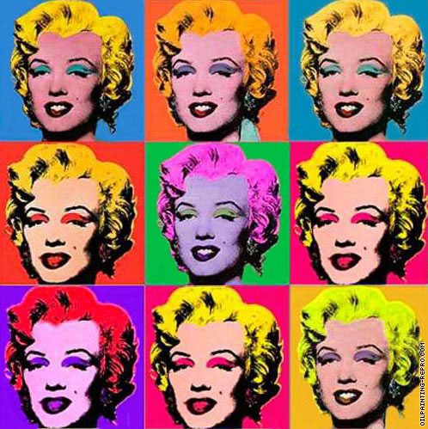
Basic steps
To keep colours realistic, use the dropper tool to select a colour from your photo before using the bucket tool.
Or use bright, wild colours instead.

Slide 10
Basic steps
Important:
Don't draw directly onto your photo layer. Add a new layer and draw onto that.

Slide 11
Basic steps
Important:
Make sure the areas you outline join up or the bucket tool will fill more than expected!

Slide 12
Extension
Some finishing touches

Slide 13
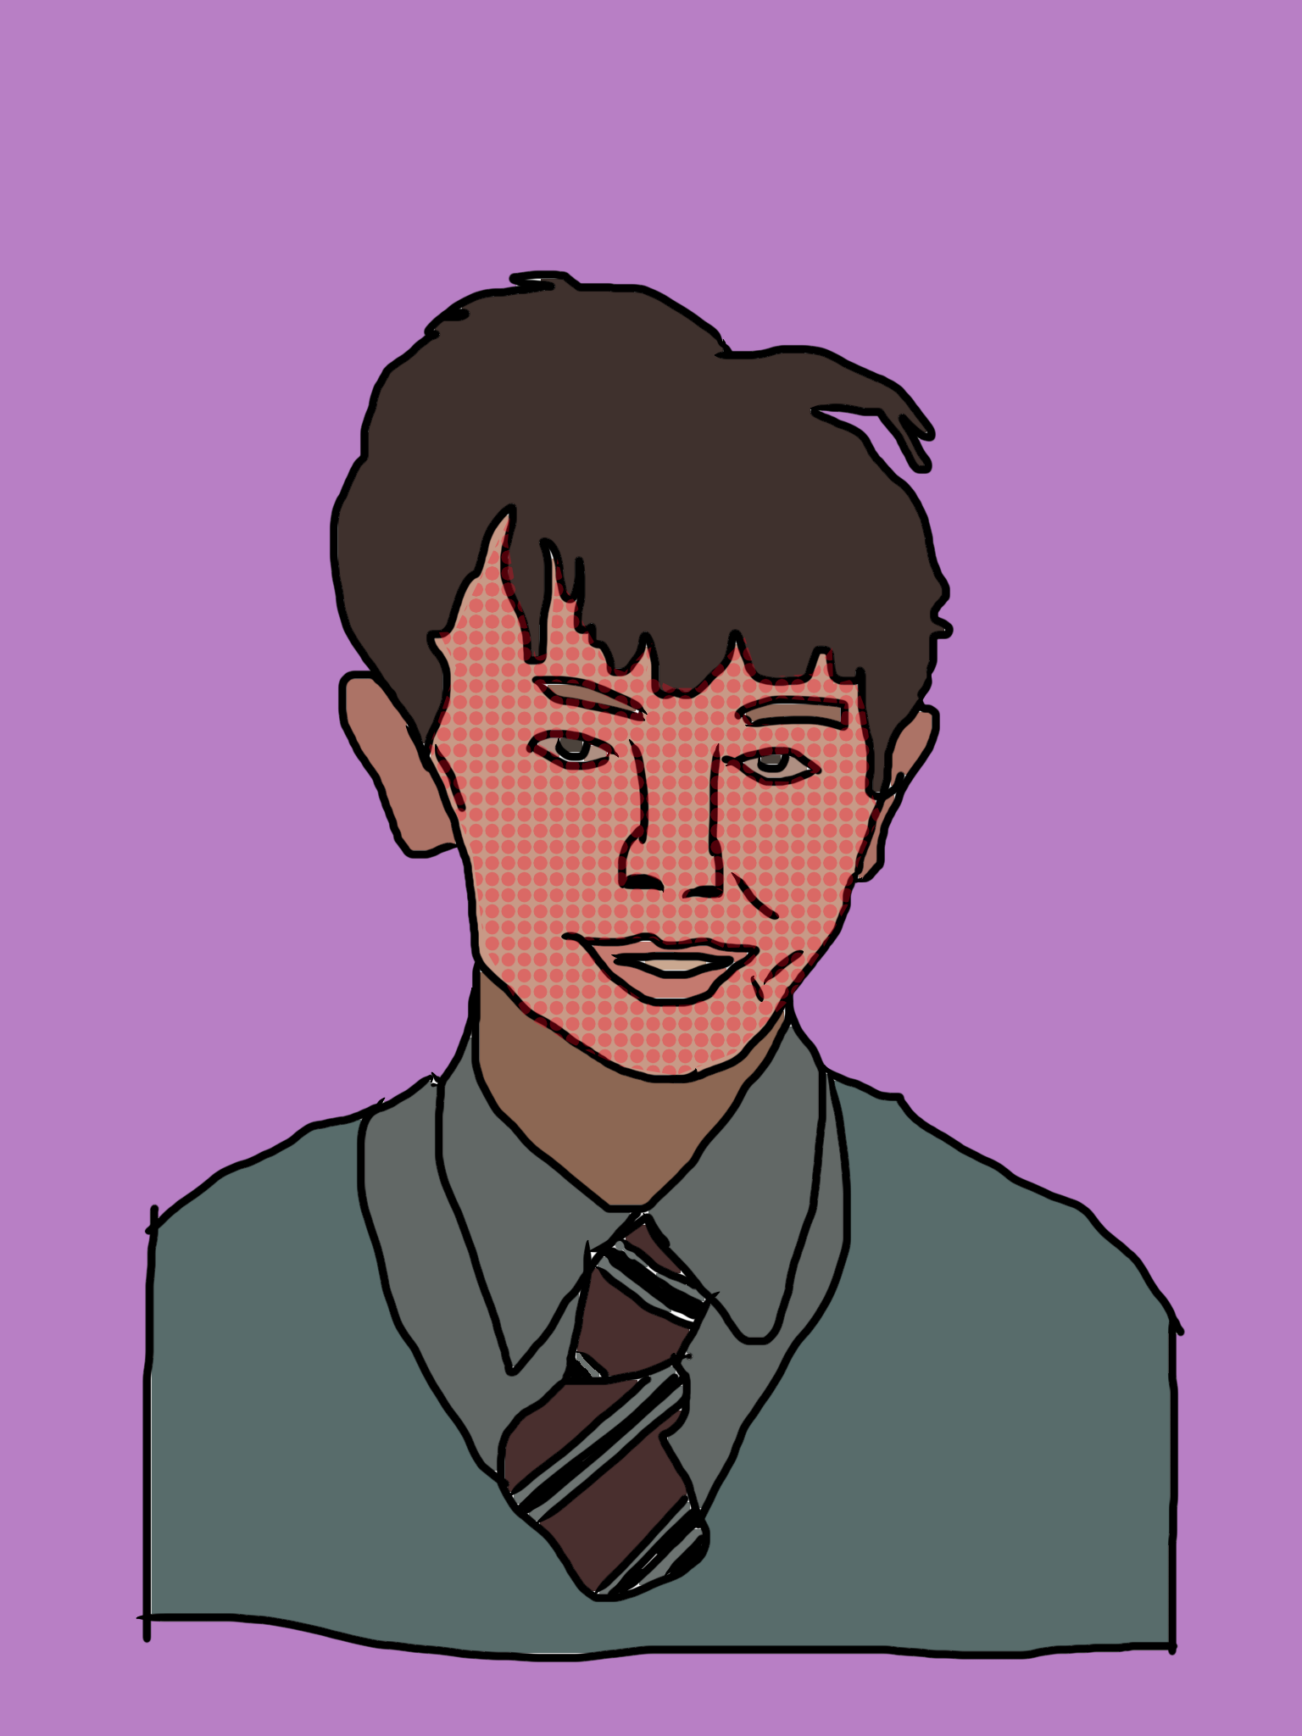
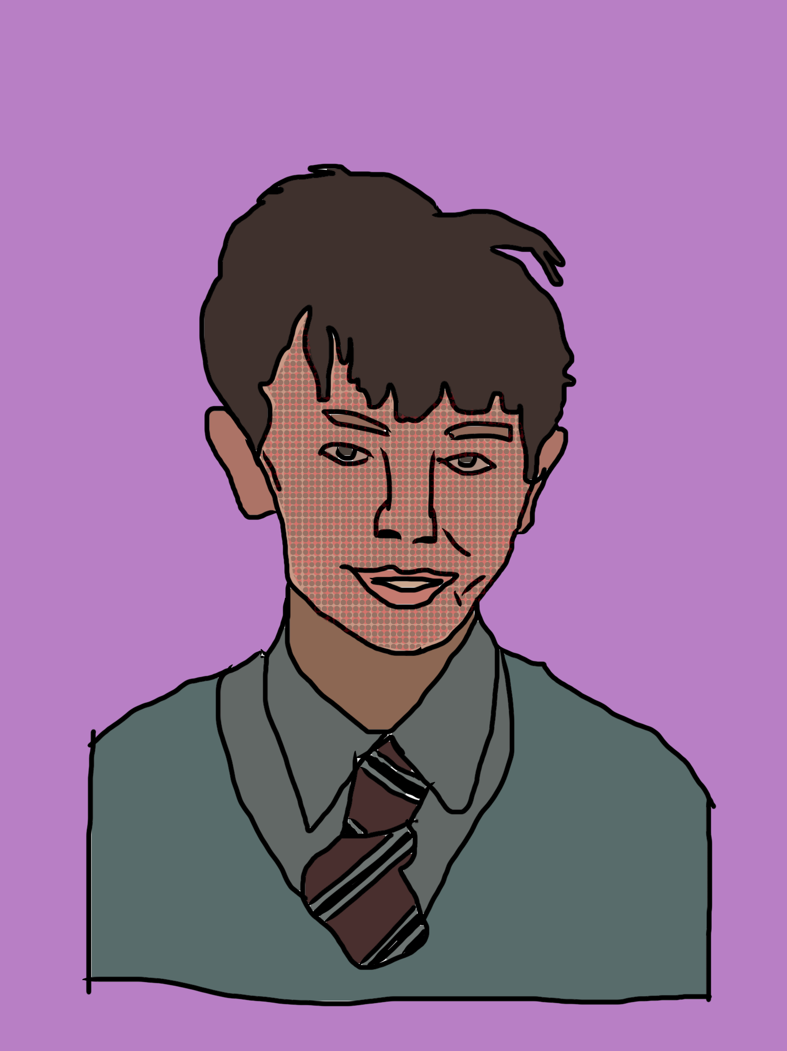
Extension
You could try adding some half-tone dots like Lichtenstein.

Slide 14
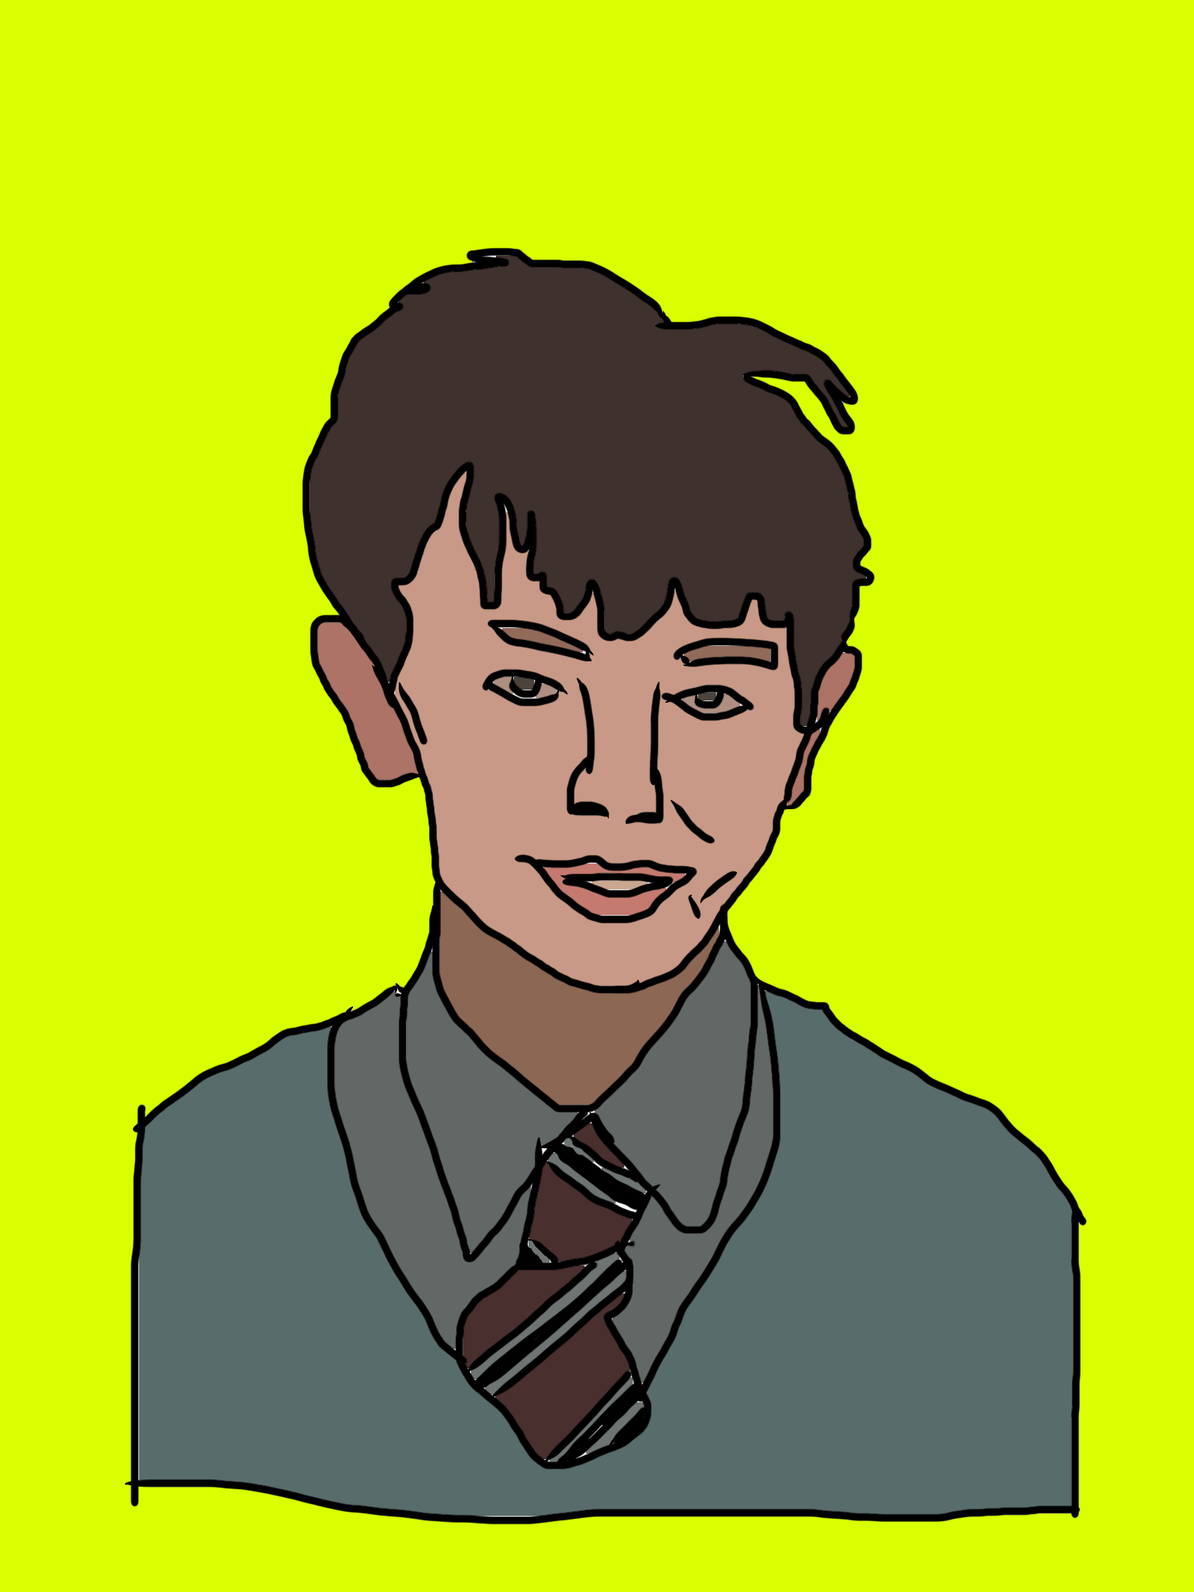
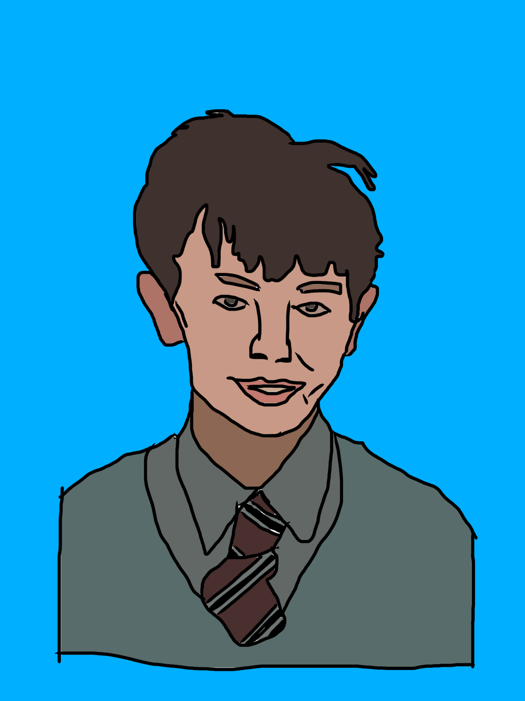
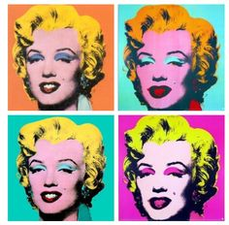
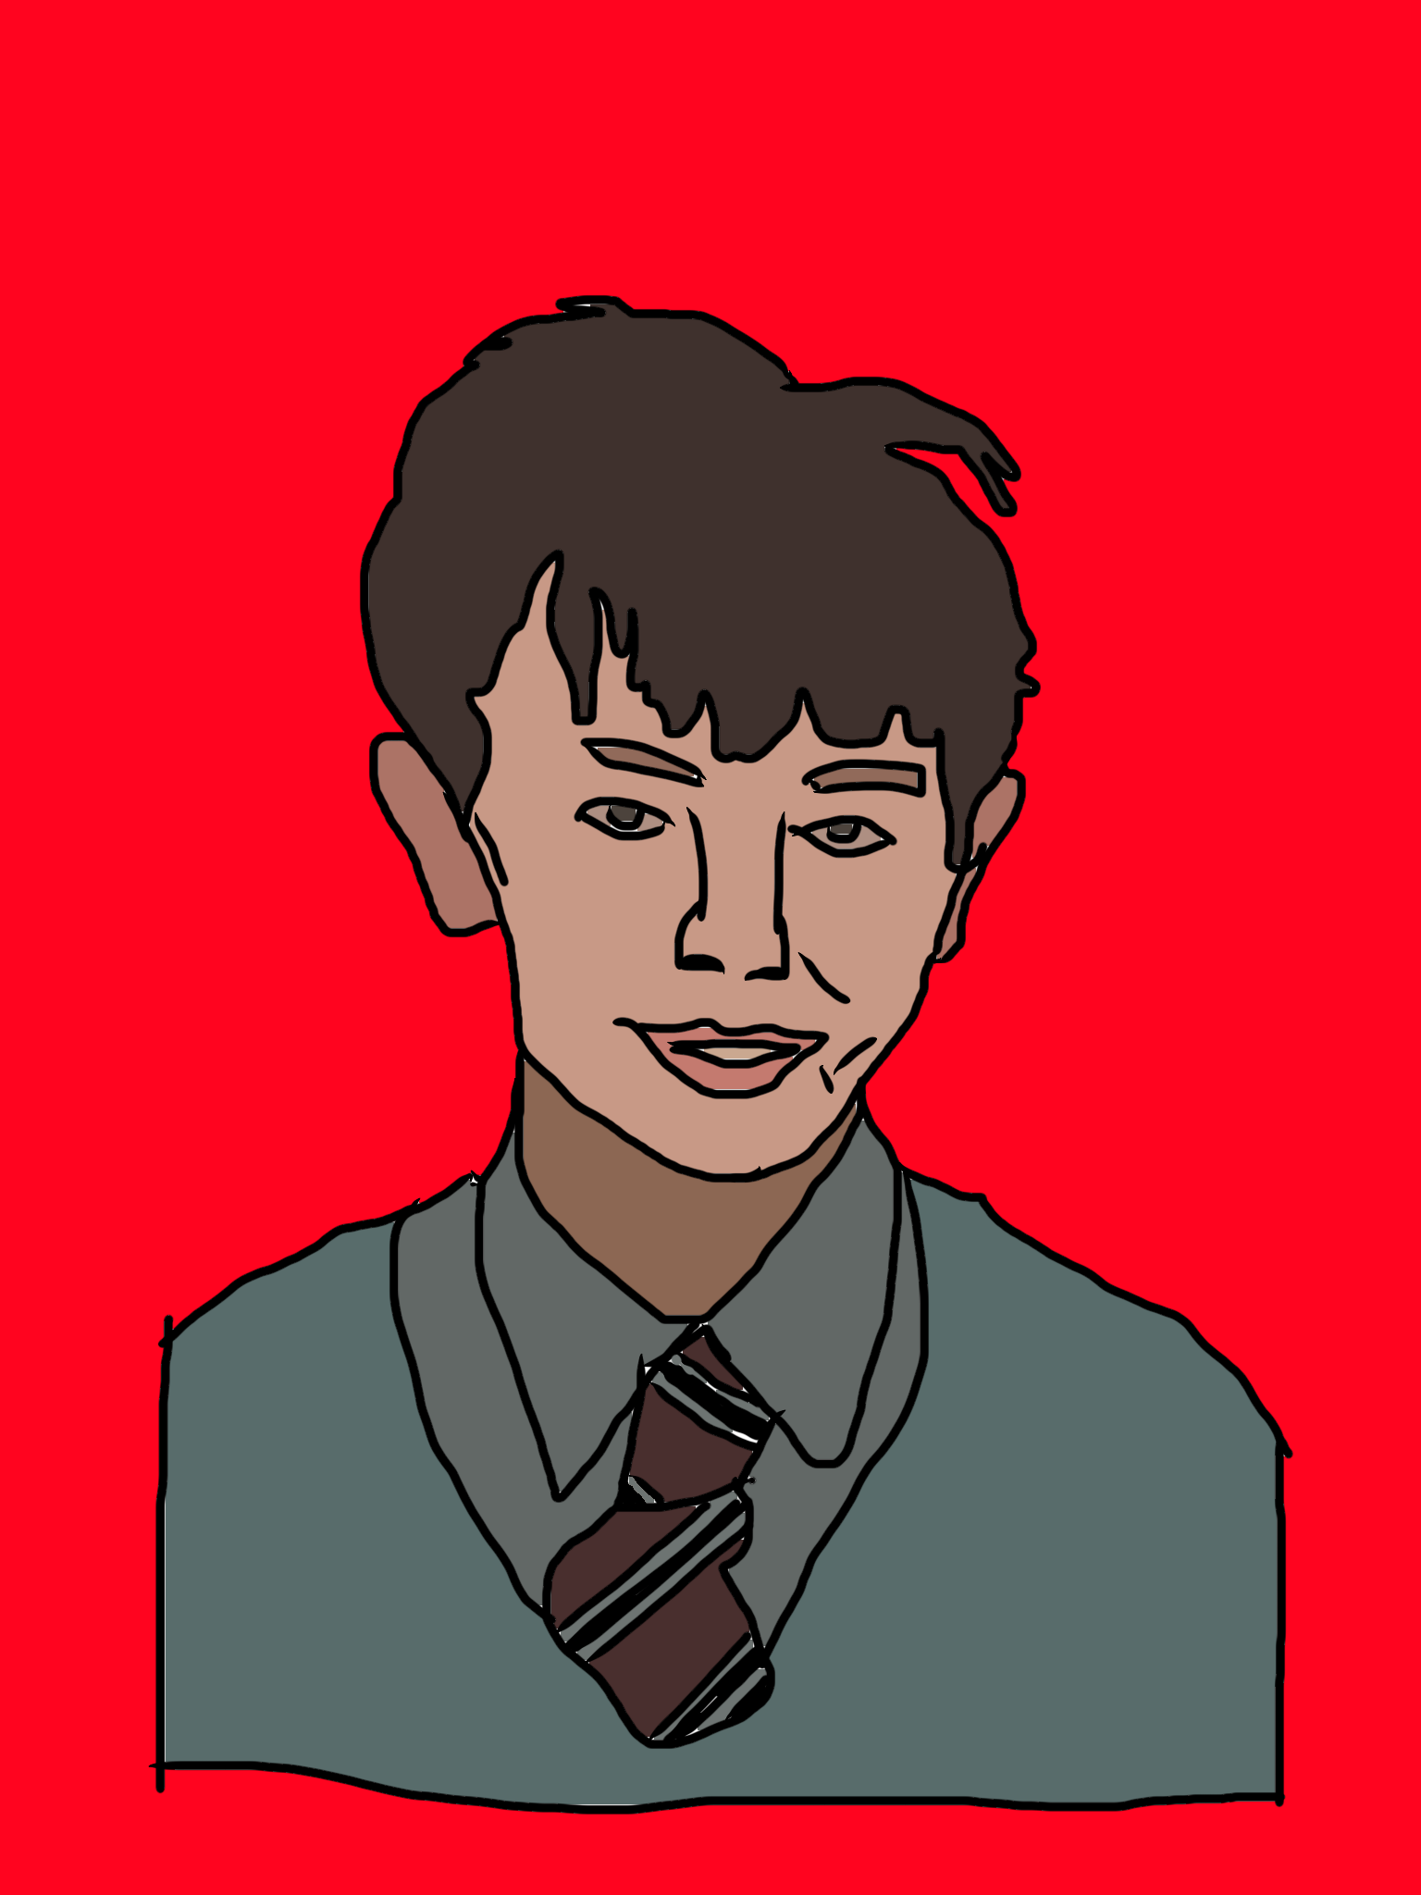
Extension
You could try arranging your finished image like Warhol.

